Slide 1
COMPARATIVE STUDY TO SOLVE TEXT CATEGORIZATION
CES Data SCIENCE 2017-2018
Jacques DoaN huu

Slide 2
PROJECT MOTIVATION
DEEP LEARning OVERTAKES CLASSICAL TECHNIQUES in nLP domain
comparE Deep learning vs classical techniques to tackLe a REaL LIFE NLP Problem
Model accuracy
Model interpretability
TOOLING
SUSTAINABILITY
POSOS startup data challenge
Categorize TEXTS RELATED TO QUEStion on DRUG INTO 51 CLASSES
Few samples, MANY MISSPELLINGS, familiar writing style, drug specific vocabulary

Slide 3
WORKBENCH ENvironment
Jupyter / python as core environment
Python packages
Matplotlib / numpy / pandas
Ntlk / pyspellschecker
Sklearn / xgboost-GPU
Keras / tensorflow-GPU
Ressources
French Fasttext model
Ansm drug repository
Hardware
Macbook pro > 32-CORE PC > AWS GPU INSTance > PC GAMER (GTX 1050 GPU)

Slide 4
Data exploration
understanding data structure helps to define the appropriate learning procedure

Slide 5
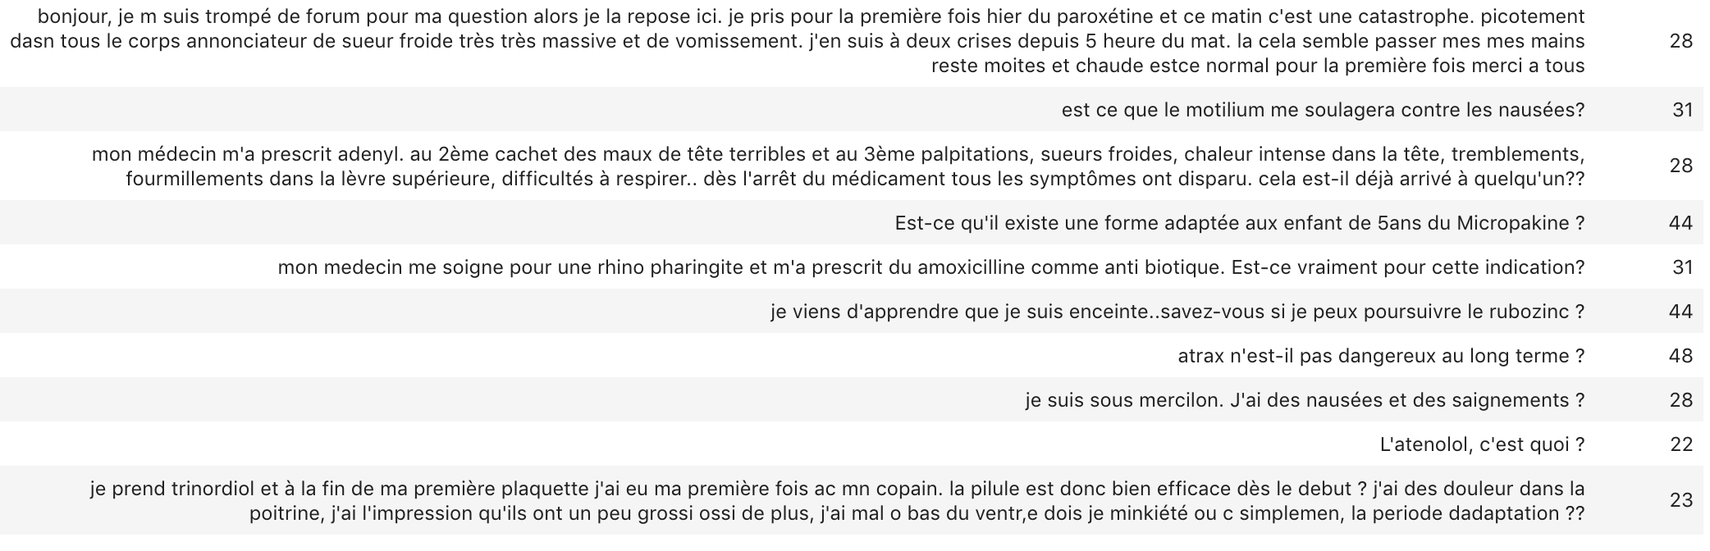
Text samples

Slide 6
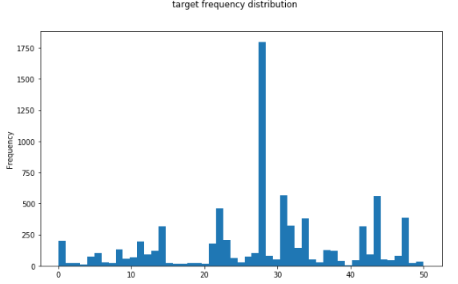
TARGET ANALYSIS
Imbalanced target distribution (51 classes)
Median is under 100 samples
8000 SAMPLES for training
Anonymized labels (1-51)

Slide 7
LABEL meaning/TOPIC EXTRACTION
Manual guess on Label semantic
1st mode : drug adverse effects
2d mode : drug-disease indication/efficiency
Automatic guess with Non negative factorization extraction
Each topic is characterized by an ordered set of components (words)
Good matching between extracted topics and manual guess
Topic #1 matches 1st mode
TOPIC components are leveraged later

Slide 8
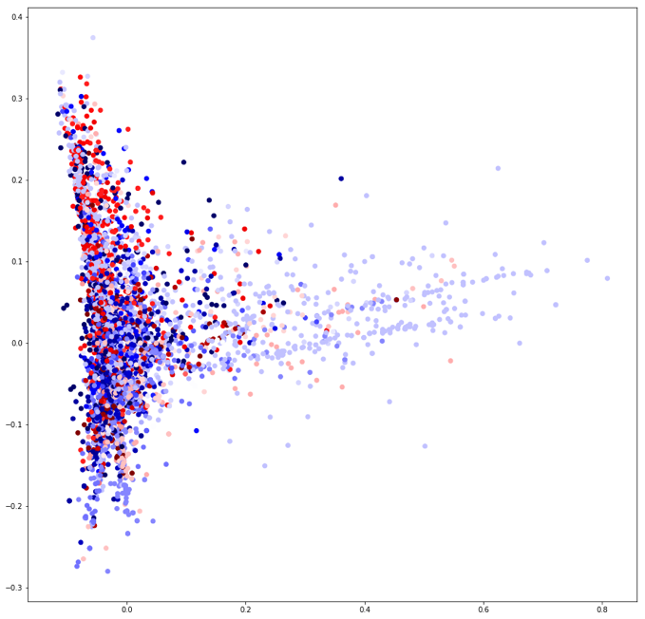
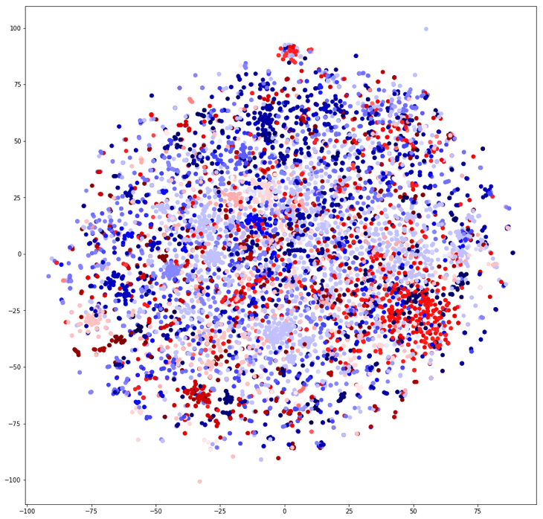
FEATURE SPACE DISTRIBUTION

Slide 9
TEXT ANATOMY

Slide 10
DOCUMENT SIMILARITY
DOC2VEC
LDA

Slide 11
GLObal MODELING PIPELINE

Slide 12
TEXT PREPROCESSING

Slide 13
Misspelling correction

Slide 14
NAMED ENTITY recognition

Slide 15
Text cleansing / normalization

Slide 16
CLASSICAL TECHNIQUES

Slide 17
Modeling elaboration

Slide 18
Text vectorization

Slide 19
FEATURE EXTRACTION

Slide 20
hyper-parameters SEARCH

Slide 21
Performance result

Slide 22
DEEP LEARNING

Slide 23
Modeling elaboration

Slide 24
Text vectorization

Slide 25
Word embedding

Slide 26
Out of vocabulary

Slide 27
Architecture candidates
Dense neural network (dnn) as naive baseline
Ad-hoc word embedding
Non sequenCE modeling
Recurrent neural network (RNN/LSTM)
General word embedding + drug domain extension
Native sequence modeling
Convolutional neural network (CNN)
General word embedding + drug domain extension
2 VARIANTS: SEQUENTAL Or parallel Convolutiona layers
Simulated sequence modeling

Slide 28
RNN / LSTM architecture

Slide 29
CNN architecture
// or sequential?

Slide 30
Hyper-parameters search

Slide 31
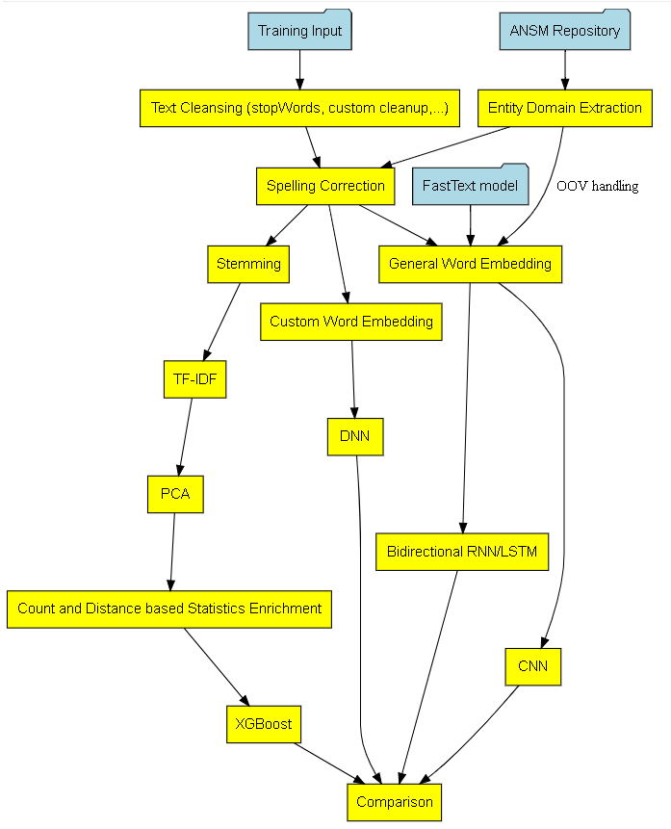
Modeling comparison

Slide 32
Model accuracy

Slide 33
Model interpretability

Slide 34
TOOLING

Slide 35
substainability

Slide 36
Winning/BEST practice
ACADEMIC Comparative study isolating techniques and their variants
Objective is to highlight their respective strength and weakness
BEST practice usually recommends to
Try several techniques and keep the one delivering the best performance
Combine them
Rnn and cnn architectures
Word embedding + manual feature extraction

Slide 37
SIMPLIFICATION : Binary classification

Slide 38
takeaways
Non conclusive performance results (64% F1-score)
Extracting sense from natural language is hard ( especially familiar french !)
Too few samples and too many target classes
Expect better gain with sequence modelinG
Unfair comparison favouring deep learning SOLUTION
rewarding Return of experience on key Data science methodology
DATA Exploration and analysis
Data preparation (feature representation)
Modeling/architecture selection
Hyper parameters search
Result analysis and improvement loop-back

Slide 39
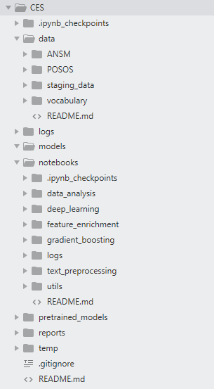
ANNEX
POSOS DATA CHALLENGE DESCRIBED AT
https://challengedata.ens.fr/fr/challenge/33/predisez_la_reponse_attendue.html
Runnable notebooks available at
https://github.com/jhuu32/CES

